Slide 1

Autonomous Predictive Maintenance System
Agentic AI for proactive service scheduling and manufacturing feedback — a secure, end-to-end solution for automotive OEMs and service networks in India.

Slide 2

1. The Problem: Reactive Service Model
Customer Pain
Operational Strain
Manufacturing Blind Spots
Visits only after failure → inconvenience, lost mobility, brand dissatisfaction.
Service center overload and inefficient slot utilization → higher turnaround times.
Recurring defects not tied quickly to production root causes → repeat failures.

Slide 3


2. Solution Snapshot
Agentic AI web platform where a Master Agent orchestrates Worker Agents to monitor vehicle health, predict failures, engage customers (voice), autonomously schedule service, and feed manufacturing insights — all protected by UEBA-based security.
Master Agent
Central orchestration, policy enforcement, UEBA checks.
Worker Agents
Diagnosis, scheduling, engagement, analytics, manufacturing feedback.
Security
UEBA logging, anomaly detection, agent-level risk scoring.

Slide 4
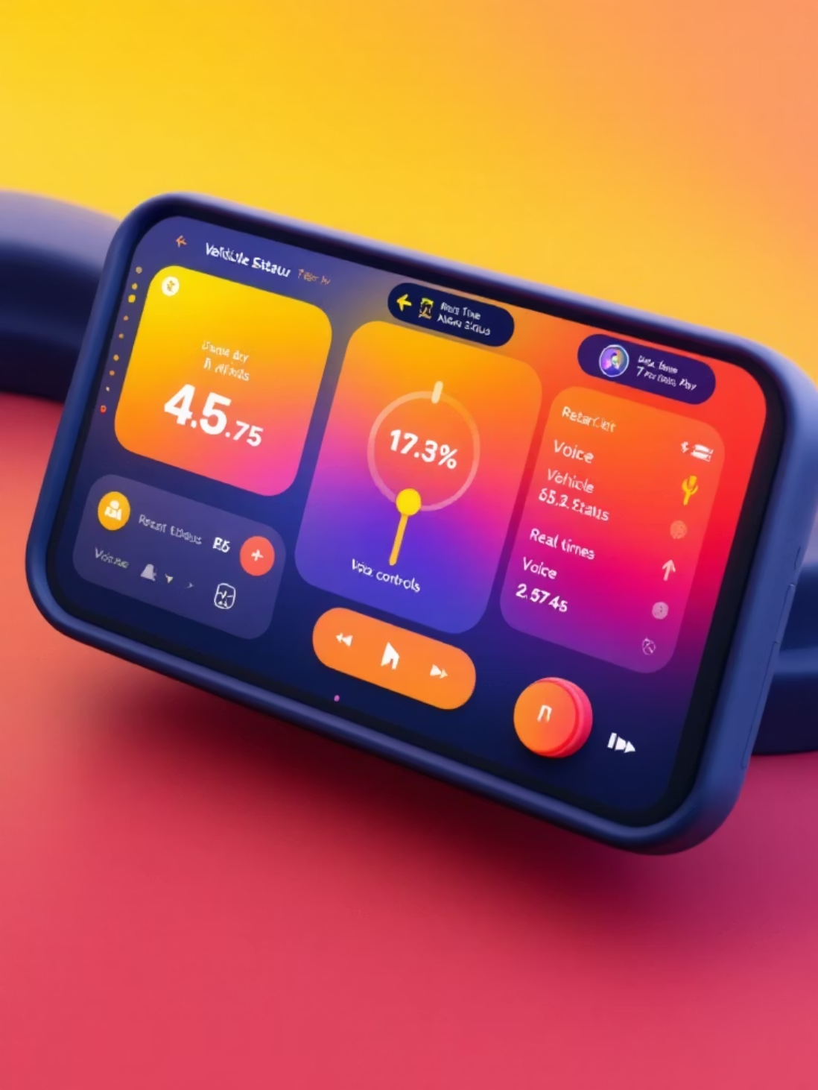
3. System Architecture (high level)
Technology Stack
Frontend: React.js dashboard with real-time telemetry & voice (SpeechSynthesis API)
Backend: Node.js + Express; Master Agent orchestrator
Worker Agents: Modular microservices for diagnosis, scheduling, engagement
DB: PostgreSQL for telemetry, bookings, CAPA records

Slide 5






4. Agent Roles & Responsibilities
Master Agent
Data Analysis Agent
Diagnosis Agent
Customer Engagement Agent
Orchestrates workers, initiates customer contact, enforces UEBA policies and risk thresholds.
Aggregates telematics, computes risk scores, flags anomalies for further diagnosis.
Interprets sensor signatures (engine temp, battery, brake wear) and recommends severity and actions.
Generates personalised voice dialogue, explains risks and benefits, captures consent.
Scheduling Agent
Manufacturing Insights Module
Fetches available slots, suggests top 3, auto-books and syncs with workshop systems.
Correlates field failures with CAPA/RCA data to identify recurring defects and recommend design/process fixes.

Slide 6

Diagnosis
Score risk and identify faults
Telemetry
Engage
Ingest raw sensor signals
Contact customer and book service
The flow shows how raw telematics turn into prioritized actions: data ingestion → automated diagnosis and risk classification → voice-based customer outreach → autonomous booking. This reduces lead time to repair and lowers downtime.

Slide 7

5. Predictive Maintenance Logic
01
02
Input Signals
Risk Scoring
Engine temperature, battery state-of-charge, brake pad wear, vibration, mileage and historical repair logs.
Rule + ML hybrid: thresholds (e.g., Engine >105°C, Battery <30%, Brake wear >80%) with probabilistic failure scores (LOW → CRITICAL).
03
Action Mapping
Each risk tier maps to recommended service windows, urgency labels, and possible parts needed — surfaced to scheduling and parts logistics.

Slide 8


6. Voice-Based Customer Engagement
Personalised, context-aware dialogues guide the customer through: greeting, problem explanation, consequence of delay, benefits of prompt service, and booking confirmation. Voice playback increases clarity and conversion; options allow confirm or defer. Conversation logs feed analytics for tone and conversion optimization.
Use local language fallbacks and regional accents to improve acceptance across India.

Slide 9

7. Autonomous Scheduling & Manufacturing Feedback
Manufacturing Feedback
Automated CAPA linkage: component → root cause → corrective action → recurrence frequency. Prioritises high-impact defects for engineering review.
Auto Scheduling
Top-3 slot suggestions, instant booking, calendar sync, technician and bay allocation — reduces coordination time and idle capacity.
Closed Loop
Field failure patterns trigger manufacturing alerts and suggested design/process improvements to reduce repeat failures.

Slide 10



8. Security, Impact & Roadmap
80%
30%
65%
Estimated reduction in unplanned downtime for high-risk vehicles
Average increase in service center throughput after automation
Field-to-manufacturing defect correlation accuracy (pilot)
Next steps: productionize ML failure models, enable real-time telematics streaming, deploy post-service feedback agent, and evolve UEBA with ML-based anomaly scoring. Business outcomes: fewer breakdowns, higher retention, optimized workshop utilization, and improved product quality — securely.

